Slide 1

Team Farthorl
C# OOP Advanced July 2016

Slide 2
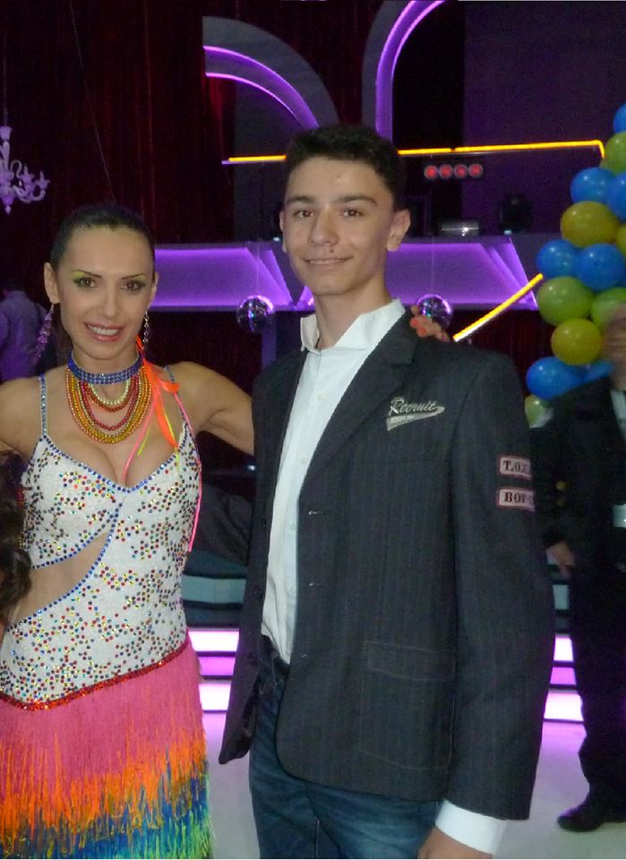
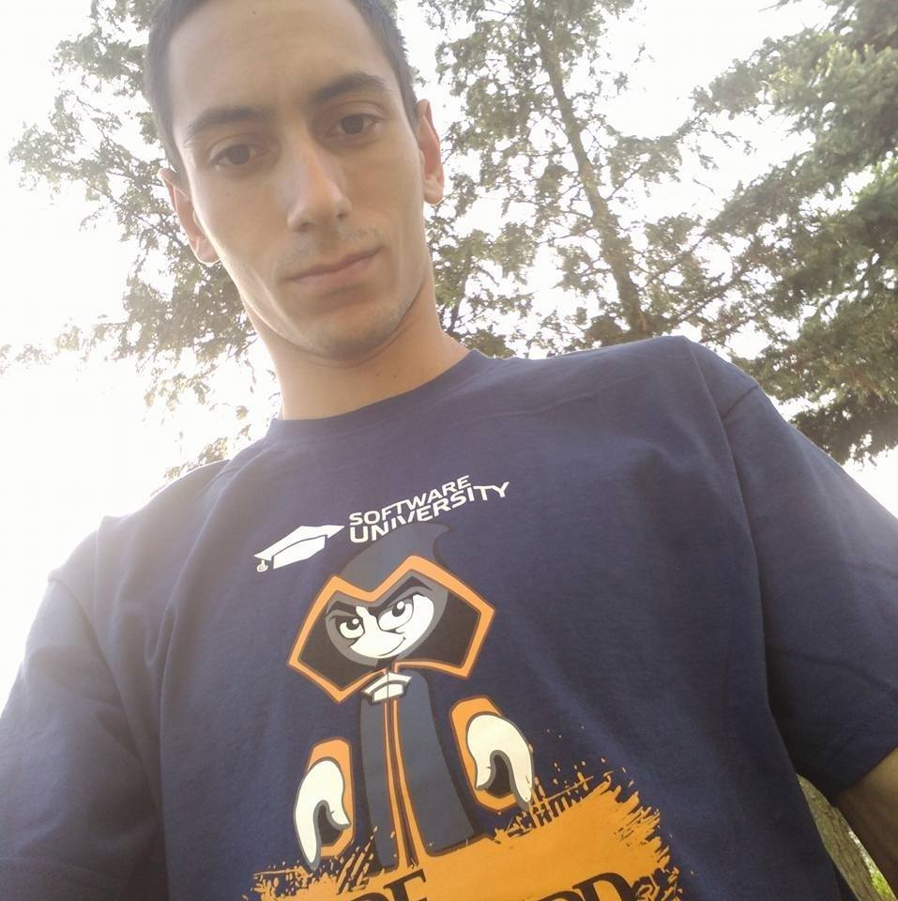


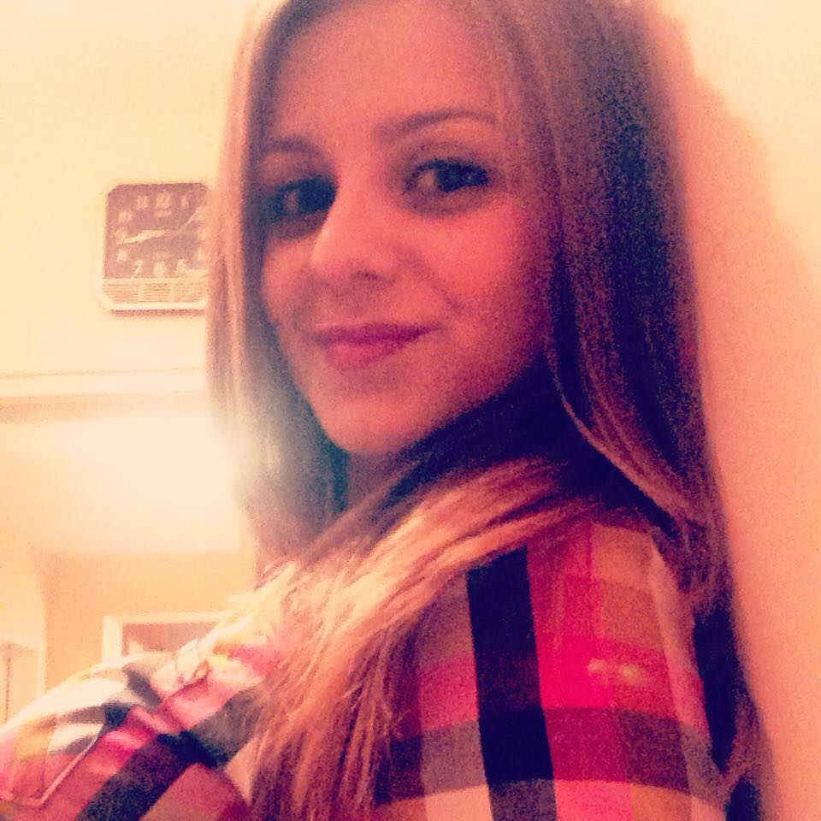



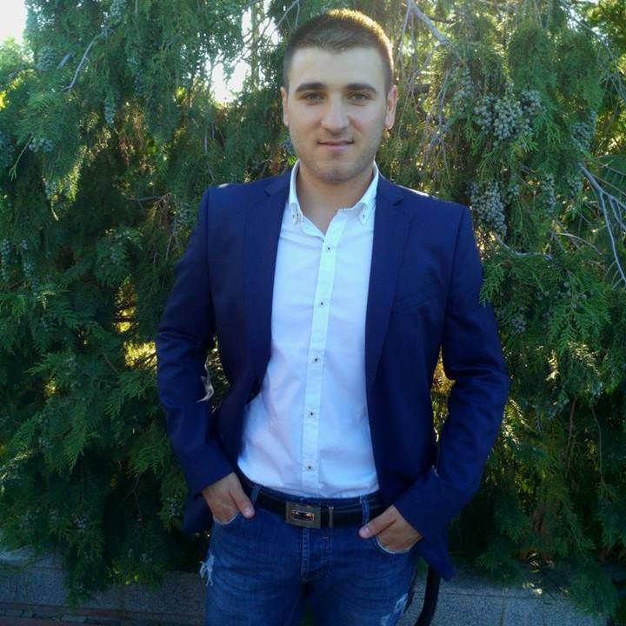

Team Members in alphabetical order :D
github.com/FarthorlTeamNew

Slide 3
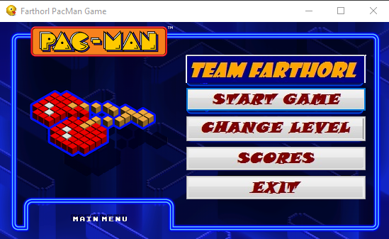
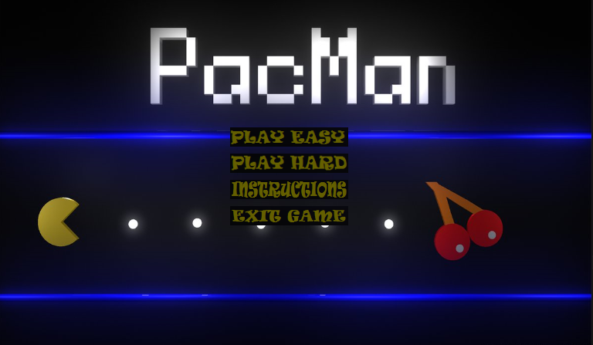
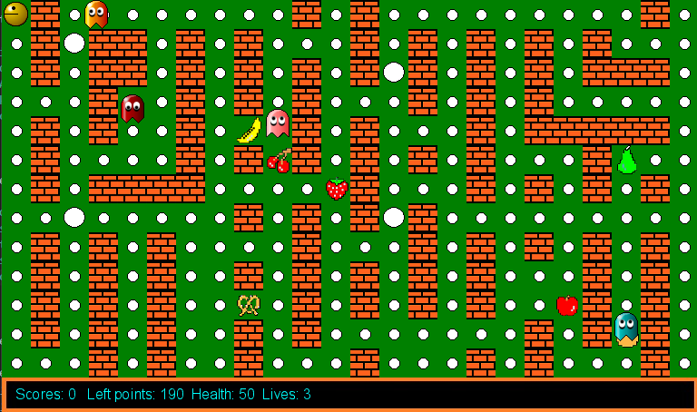
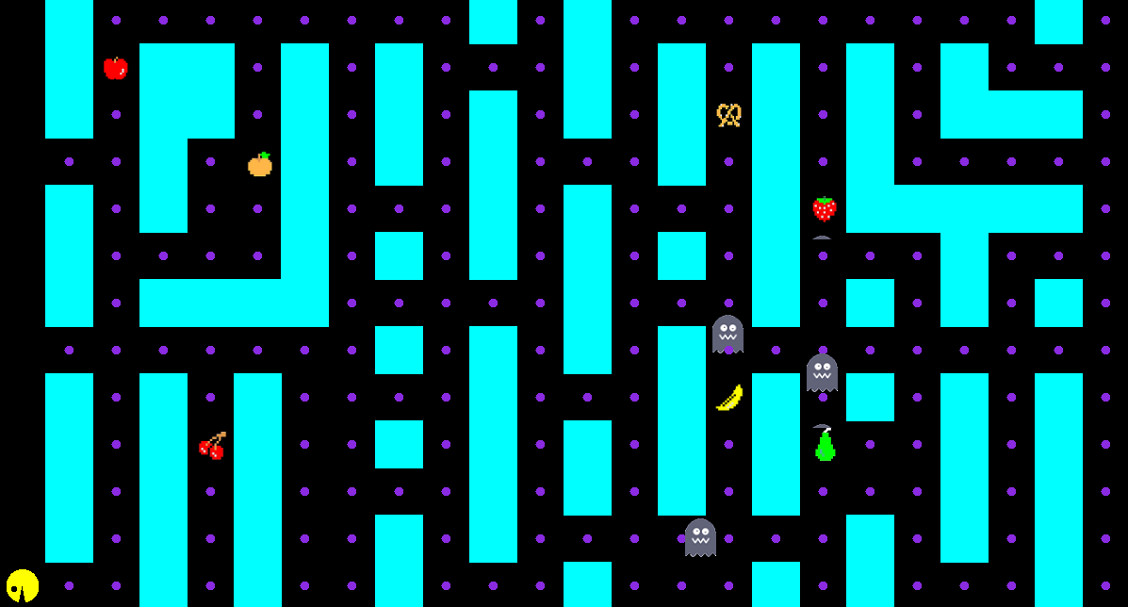
v. 0.0003
v. 0.01

Slide 4







(Original) Pac-Man Sounds Click the speaker to hear it’s sound
Ready!
Intermission
Eating Dots
Eating Ghost
Eating Fruit
Extra Life
Death

Slide 5
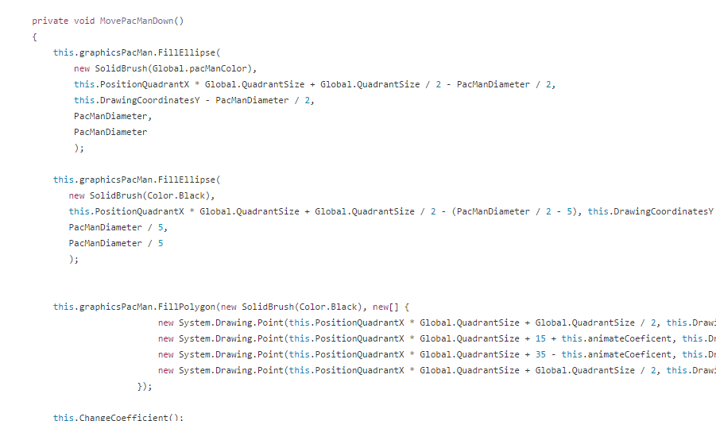
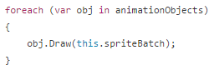
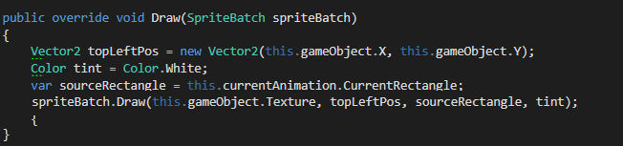
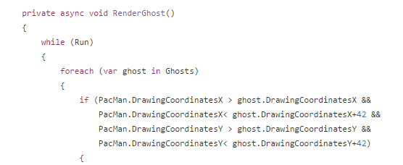
Migration
Windows Forms
MonoGame

Slide 6
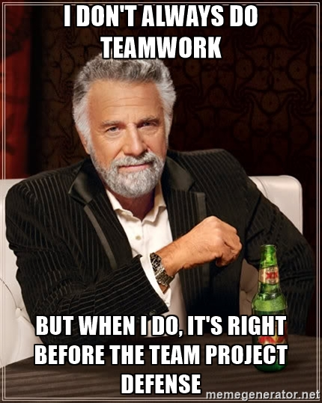
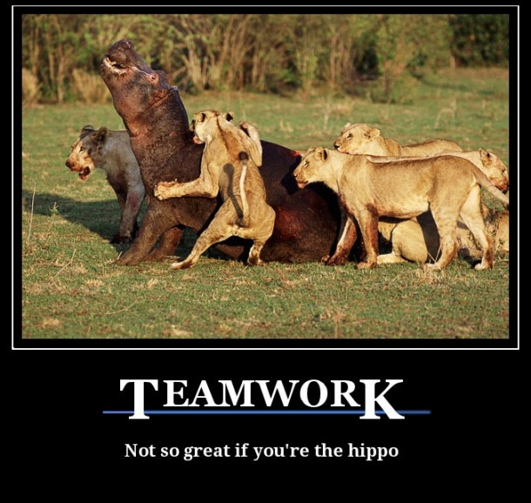
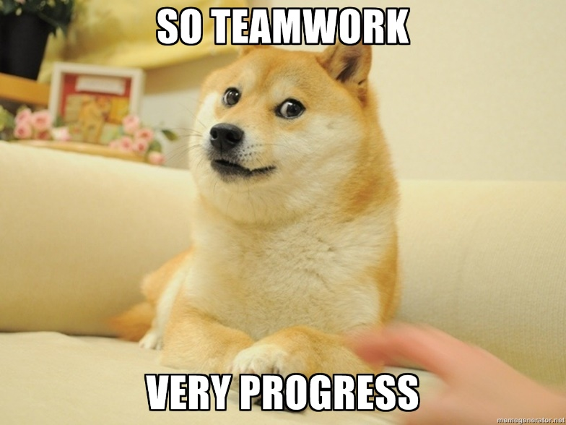
TEAMWORK

Slide 7
Main Focus during C# OOP Advanced
Cohesion and Coupling
Enums
Reflection

Slide 8
Promises kept:
(Finally!) Migrated to MonoGame.
Made a Factory for generating Fruit.
When you finish a level or die, you see a pop-up message, which prompts you to either get back to menu or retry level.
Implemented several Pathfinding “algorithms”. Some of the good ones relentlessly chase PacMan, and run in opposite directions when PacMan can eat them.
Improved difficulty by adding various effects for fruit.
Organized the project structure. Moved classes to wherever they belong.

Slide 9
